Slide 1
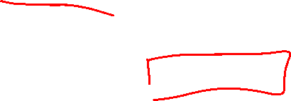
Section 2.2 Limit of a Function
Lecture 1
Idea of limit
Notes:
Section is shorter than most

Slide 2
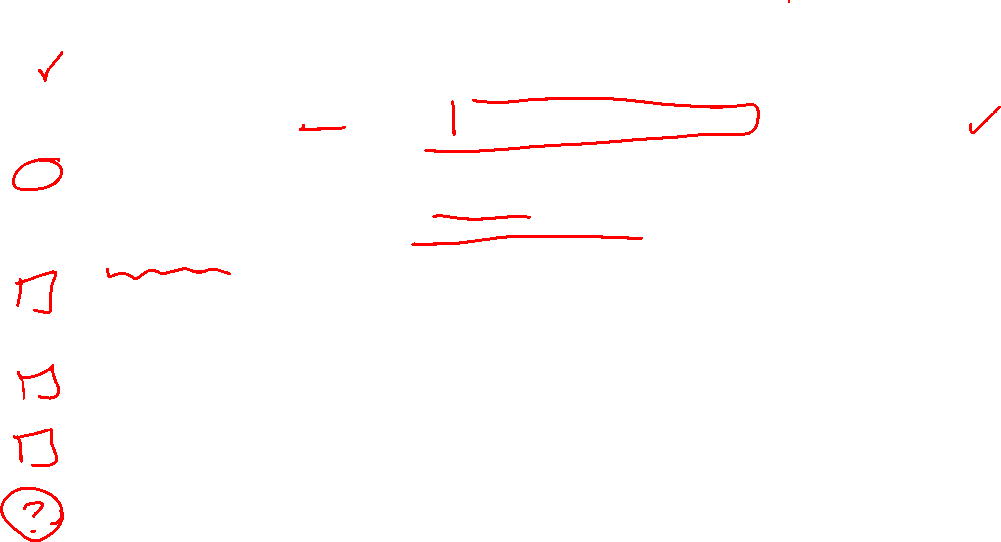
Homework Submission to Canvas
Preview of section
Skim the section in text and write a short paragraph summary.
Give a bulleted list of all important definitions, theorems, and formulas without details.
Notes on video lectures
Take notes on everything written on slides including all details, worked examples, on-own activities, as well as your own thoughts and questions.
Try on-own activities first, then write down provided solution next to it for comparison.
Worked examples from the text
Write down the problem and attempt without looking at the solution.
Use the solution to write the best explanation you can.
Solutions to textbook exercises
Model approaches and explanations given in the video lectures and textbook examples.
Final reflection of section
List the key takeaways to remember as a bulleted list.
Video reflection (for some sections)
Write a 1 paragraph reflection on the video discussing what you found most interesting or useful.
Notes:
Mention graded for completion and quality of writing.

Slide 3
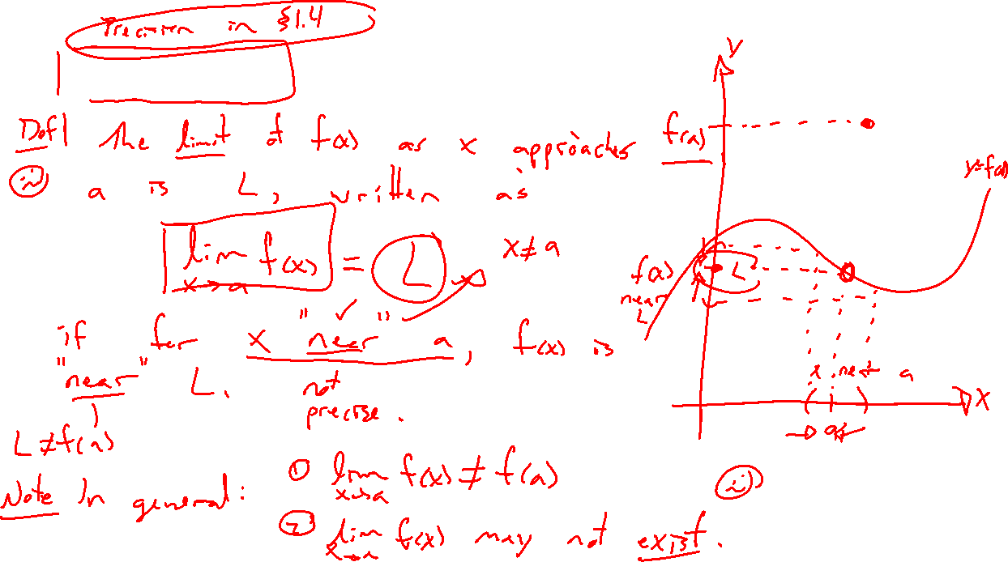
Idea of limit and notation
Notes:
Lim_{x \rightarrow a} f(x) = L
Draw picture, careful language, how to read notation, idea only here, fuzzy and not careful.
Distinction between limit and f(a), may differ or same. Show can move f(a) in picture.
Possible limit doesn’t exist.
Seems silly and weird and confusing.

Slide 4
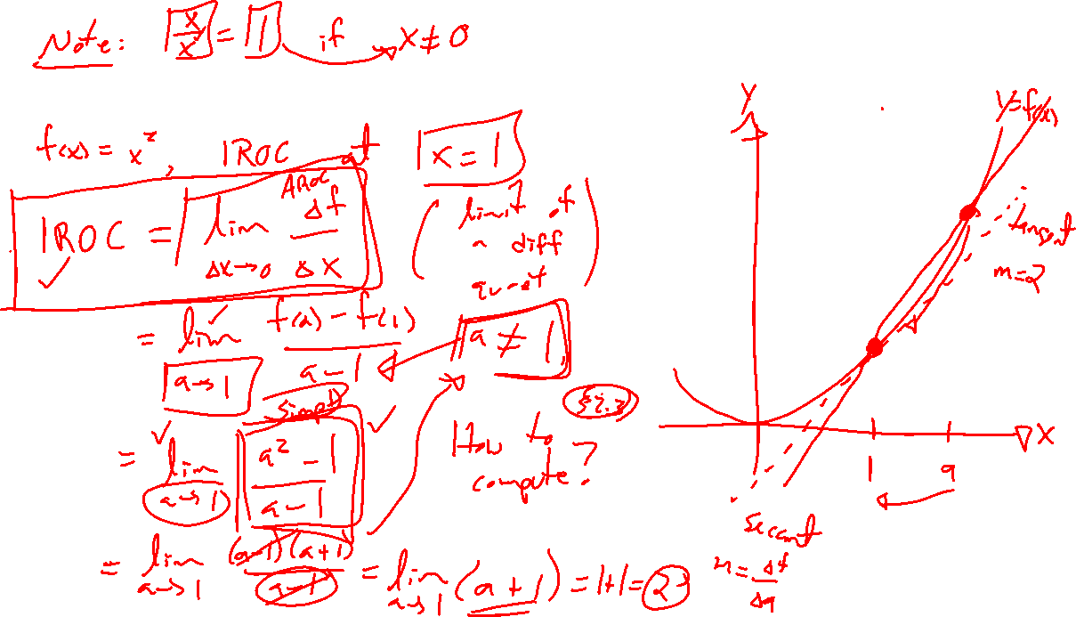
Example: Return of IROC
Notes:
Example from last section: IROC at x=2 for f(x)=x^2
Limit of diff quotient, undefined at zero.
Plot diff quotient in desmos, show can remove zero division by factoring and simplifying, called removable discontinuity.
Limit def of IROC

Slide 5
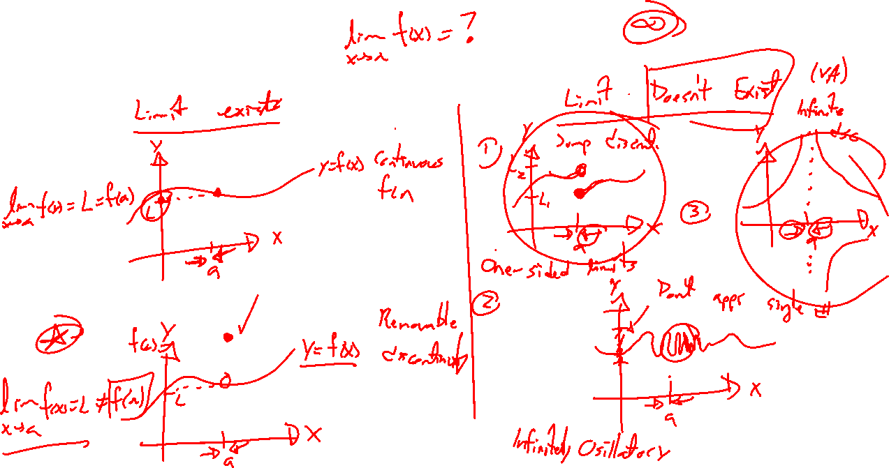
Limit existence
Notes:
Limit may or may not exist.
Heaviside function, vertical asymptote, sin(1/x) oscillation
Need to approach a single finite number as get closer.
Will handle these situtions in lecture 2.

Slide 6
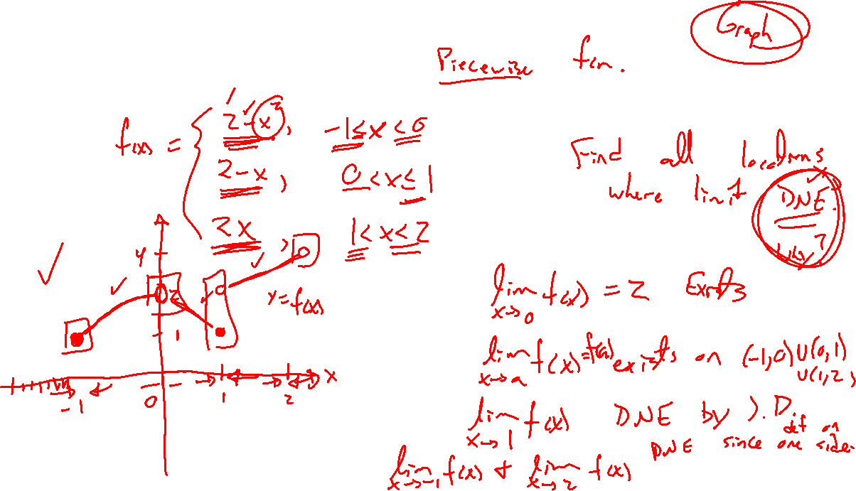
Example: Try on own
Notes:
Reminder to pause, side by side in notes.
Peicewise function. Graph on own, and sort out limits everywhere in domain.
F(x) = 2-x^2 (-1<=x<0)
2-x (0<x<=1)
2x (1<x<2)

